Slide 1
SQL
Ádám Bene

Slide 2
Definition
Structured Query Language
Domain specific computer language
For relational databases
Usage
CRUD - Create - Read - Update -Delete

Slide 3
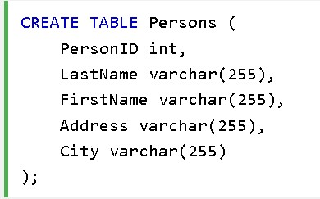

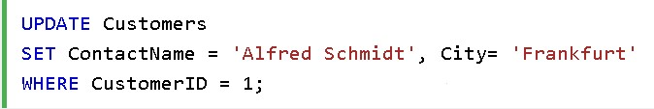
Create
Read
Update
Delete

Slide 4
Alternatives
No real alternative
Frontends: - .NET: LINQ - Scala: ScalaQL - Ruby: SqlStatement, ActiveRecord - Haskell: HaskellDB - others

Slide 5
SQL injection
txtUserId = getRequestString("UserId");
txtSQL = "SELECT * FROM Users
WHERE UserId = " + txtUserId;
---------------------------------------------------------------------------------------------------------------
SELECT UserId, Name, Password FROM Users
WHERE UserId = 105 or 1=1;
Countermeasure
txtNam = getRequestString("CustomerName");
txtAdd = getRequestString("Address");
txtCit = getRequestString("City");
txtSQL = "INSERT INTO Customers (CustomerName,Address,City) Values(@0,@1,@2)";
db.Execute(txtSQL,txtNam,txtAdd,txtCit);

